Slide 1
BCI Board Implementation
Andrew Schaefer, Tianzhe Hu, Zihan Lin
Client: Dr. Wenyao Xu

Slide 2
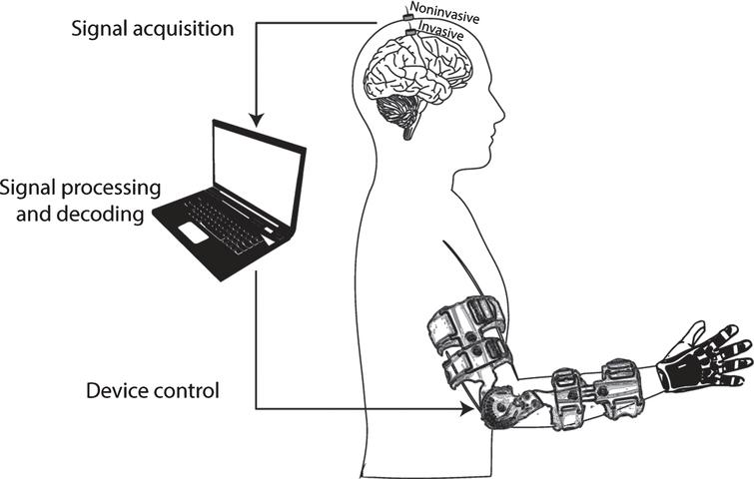
Introduction
Why BCI?
Rehabilitation
Biometrics
Medical diagnosis
Fig 1: Diagram of BCI being used to control a prosthetic arm (Lopez-Larraz)

Slide 3
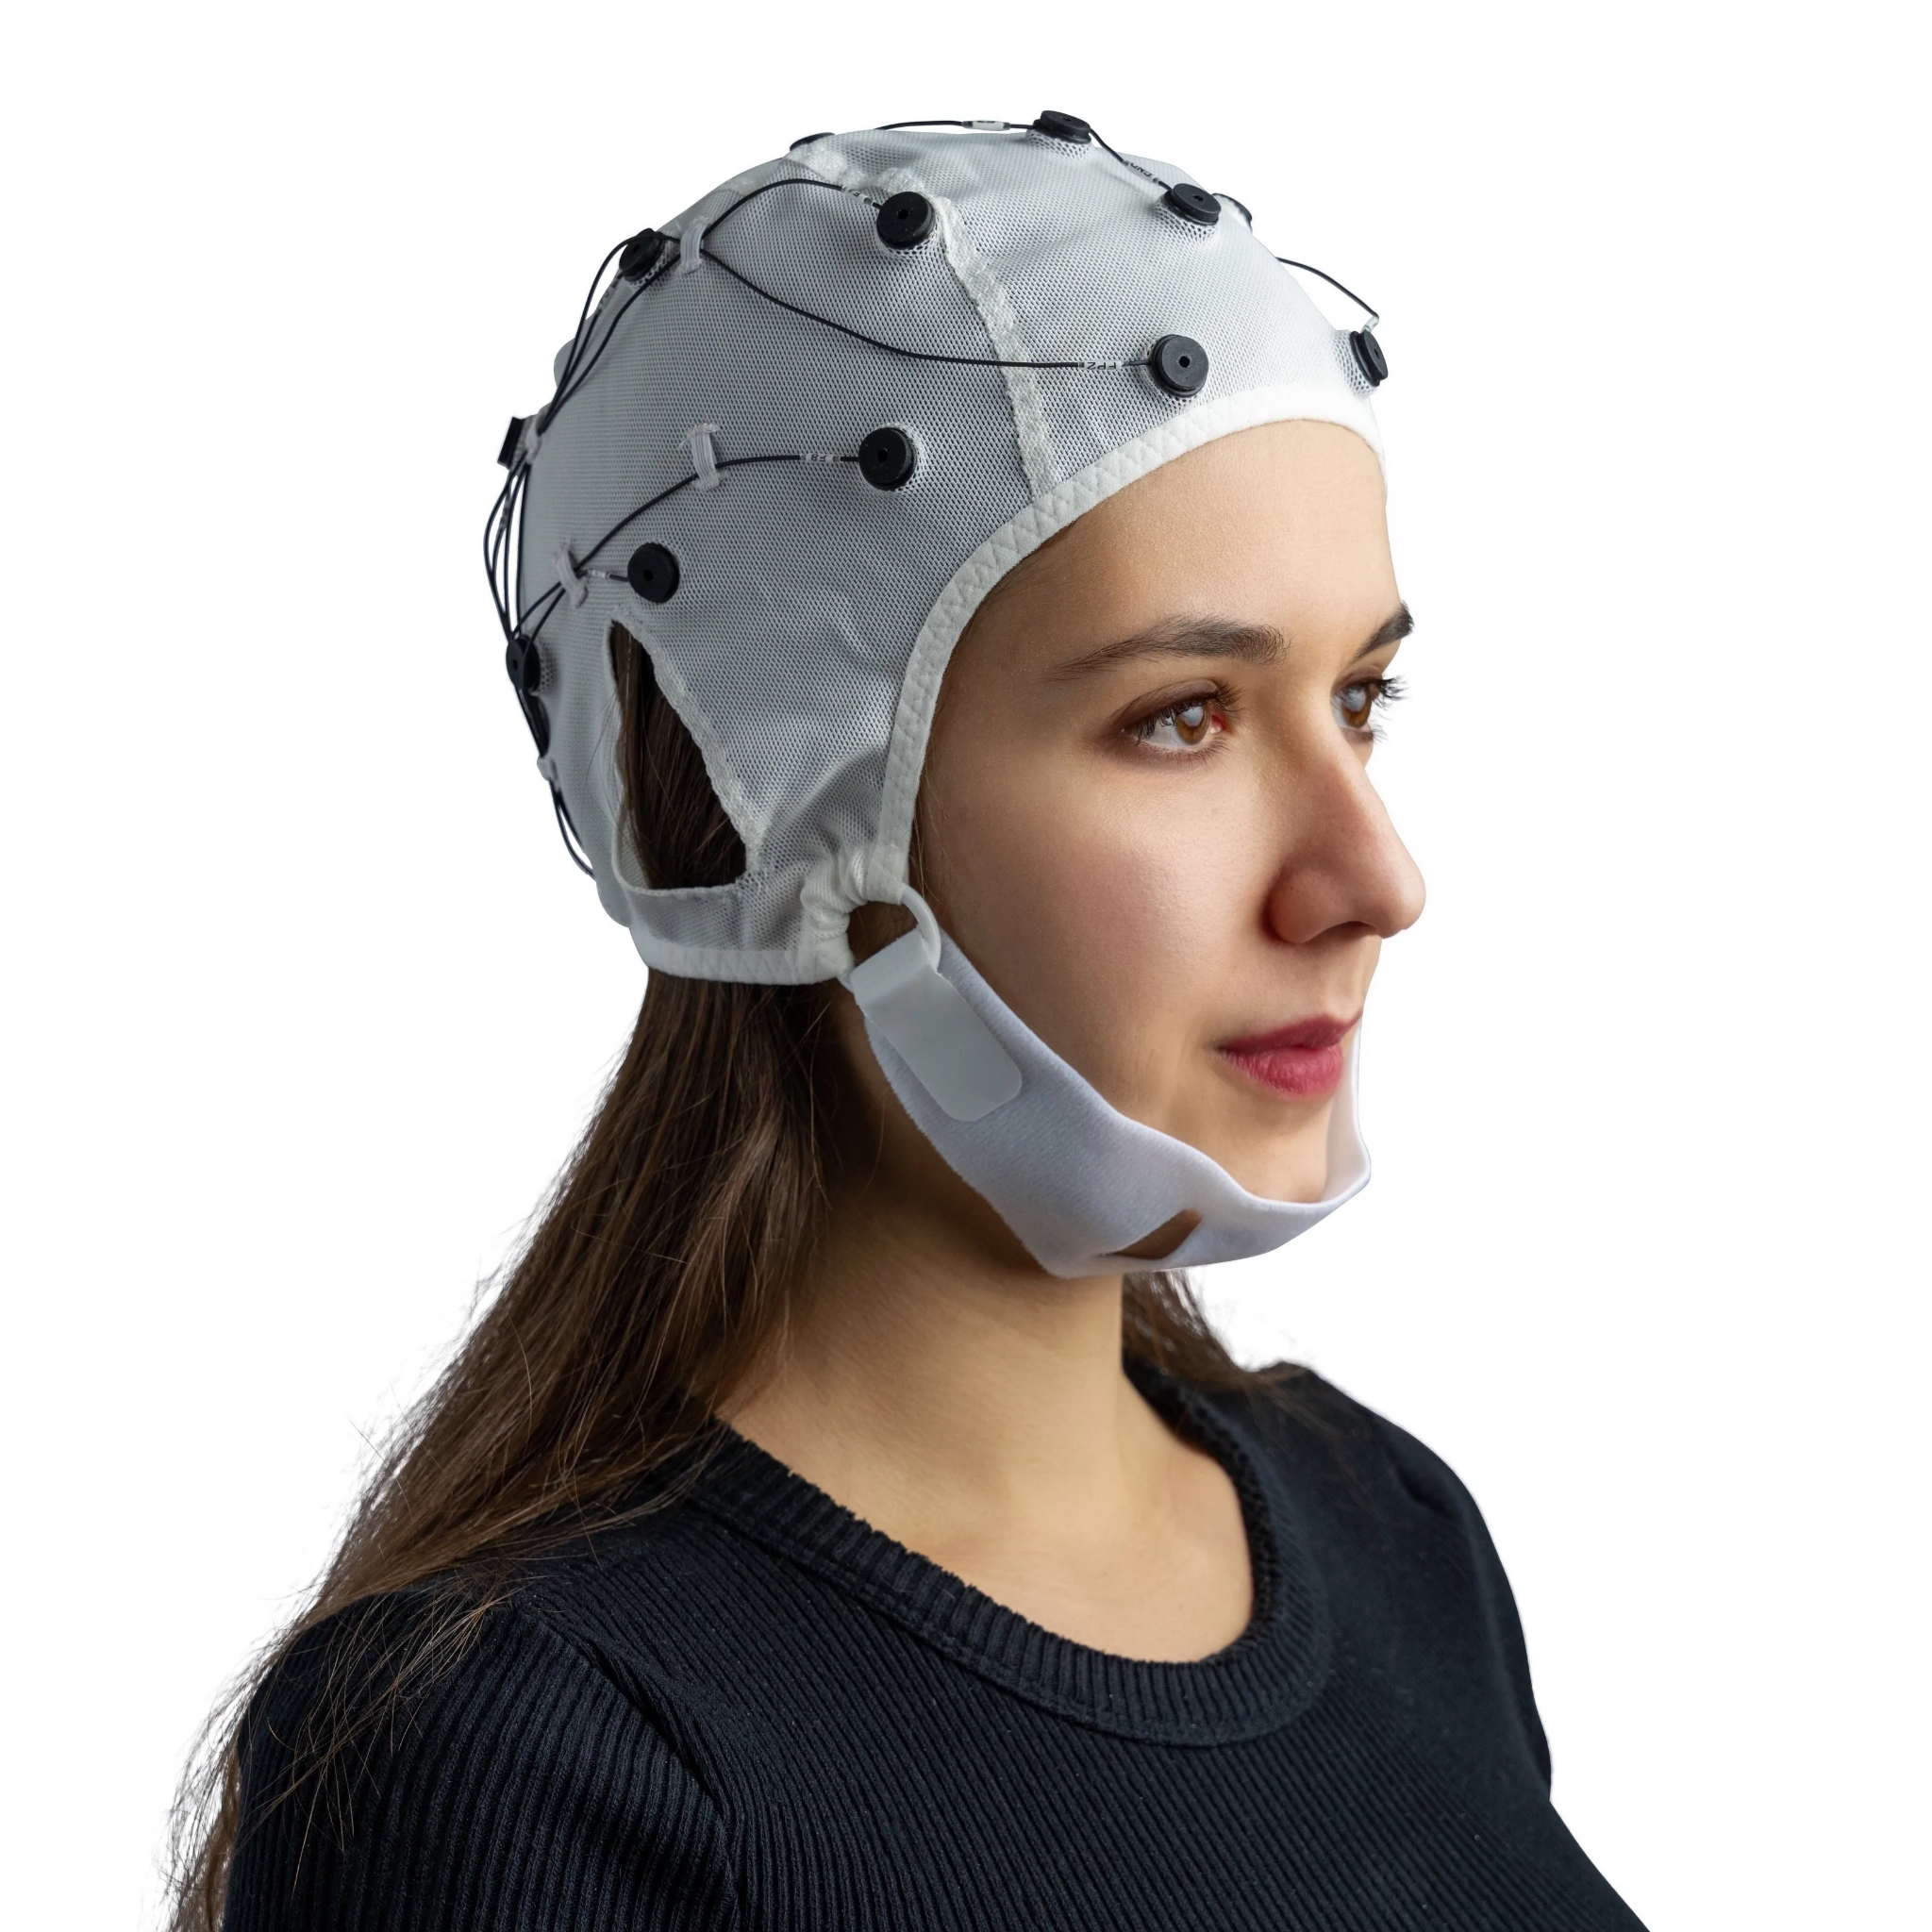
Discussion
Our board will collect EEG Data
EEG:
Electrodes placed on scalp
Measures brain signals
Signals can then be processed to understand meaning
Fig 2: EEG Electrode Cap (OpenBCI)

Slide 4
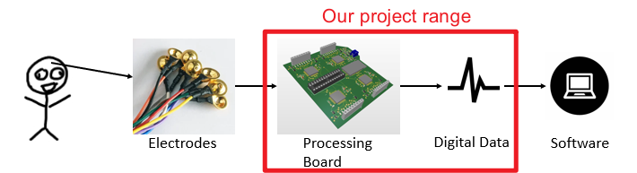
Project Overview
This is a hardware implementation only project, no algorithm or software development needed.
The implementation includes PCB design, hardware driver code, and data transfer code.
Notes:
A general look out of what does this project look like. (Point out we are focusing on the board implementation!!!)

Slide 5
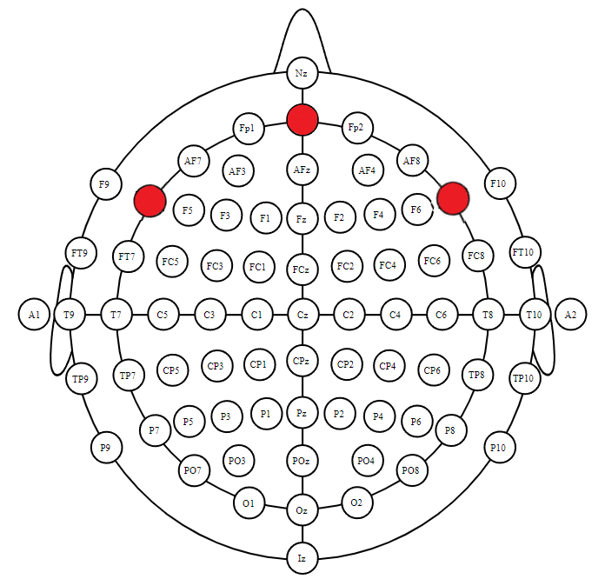
What is BCI
BCI, called Brain Computer Interface, is using the brainwave to interact with peripheral devices. Our project uses the computer to record the activity of brainwaves as digital data by using AD converter and Bluetooth.
Fig 1: 10-20 Internationally Accepted EEG Node Placement.
(red circles represent areas where flat electrodes can be placed)

Slide 6
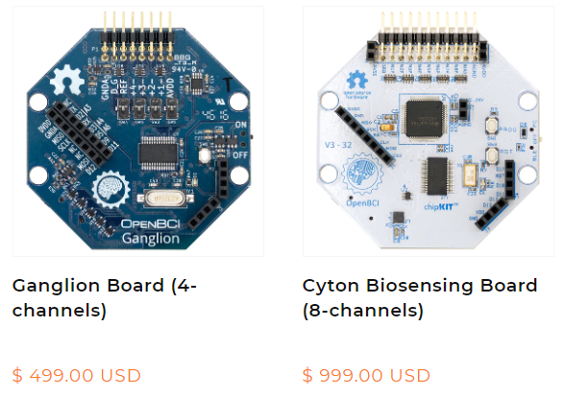
Requirements & Goals
Requirement:
Convert analog brainwave to digital data
Stream digital data over bluetooth
Goal:
Manufacturing a PCB board that can replace the board from OpenBCI. Compare to OpenBCI board, our PCB board is:
Supporting More Channels
For example
16 channels EEG
4 channels EOG
Cheaper
Fig 2: The Price and supported Channels of OpenBCI boards
Notes:
Step into the board start from the Requirement & Goals of the board. (What should this board deliver? Features?)

Slide 7
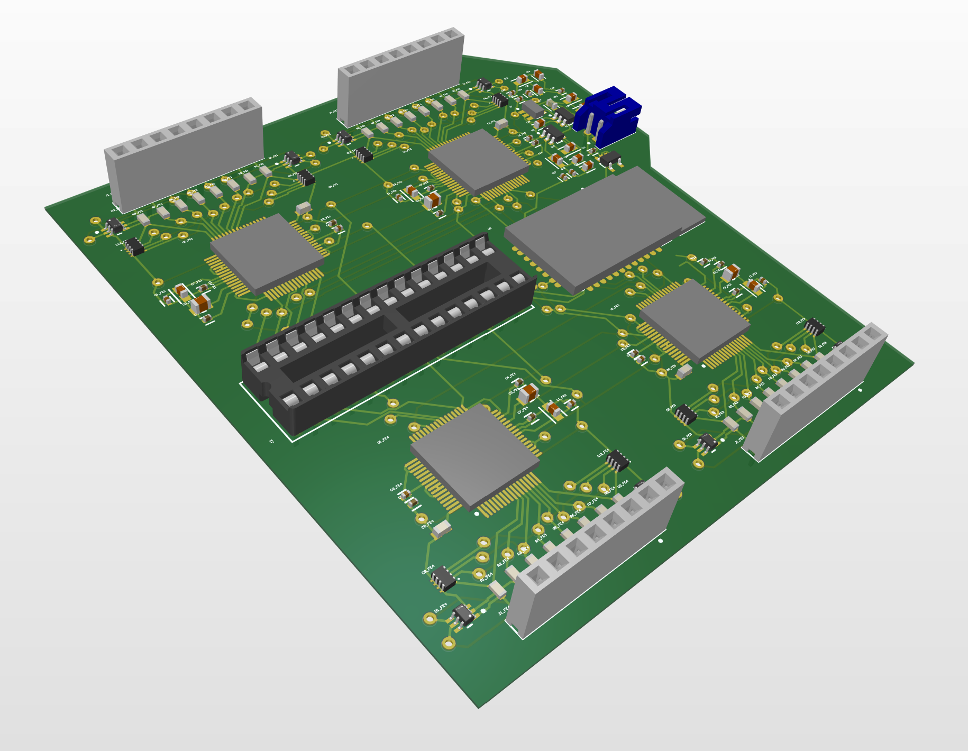
Board Specifications
Power with 5V DC Battery ONLY
ATMEGA328P Microcontroller
ADS1194 Analog Front End
Pmod BT2 Bluetooth
Board Dimensions 3.1 x 3.3 inches
Notes:
A general information for the board specifications

Slide 8
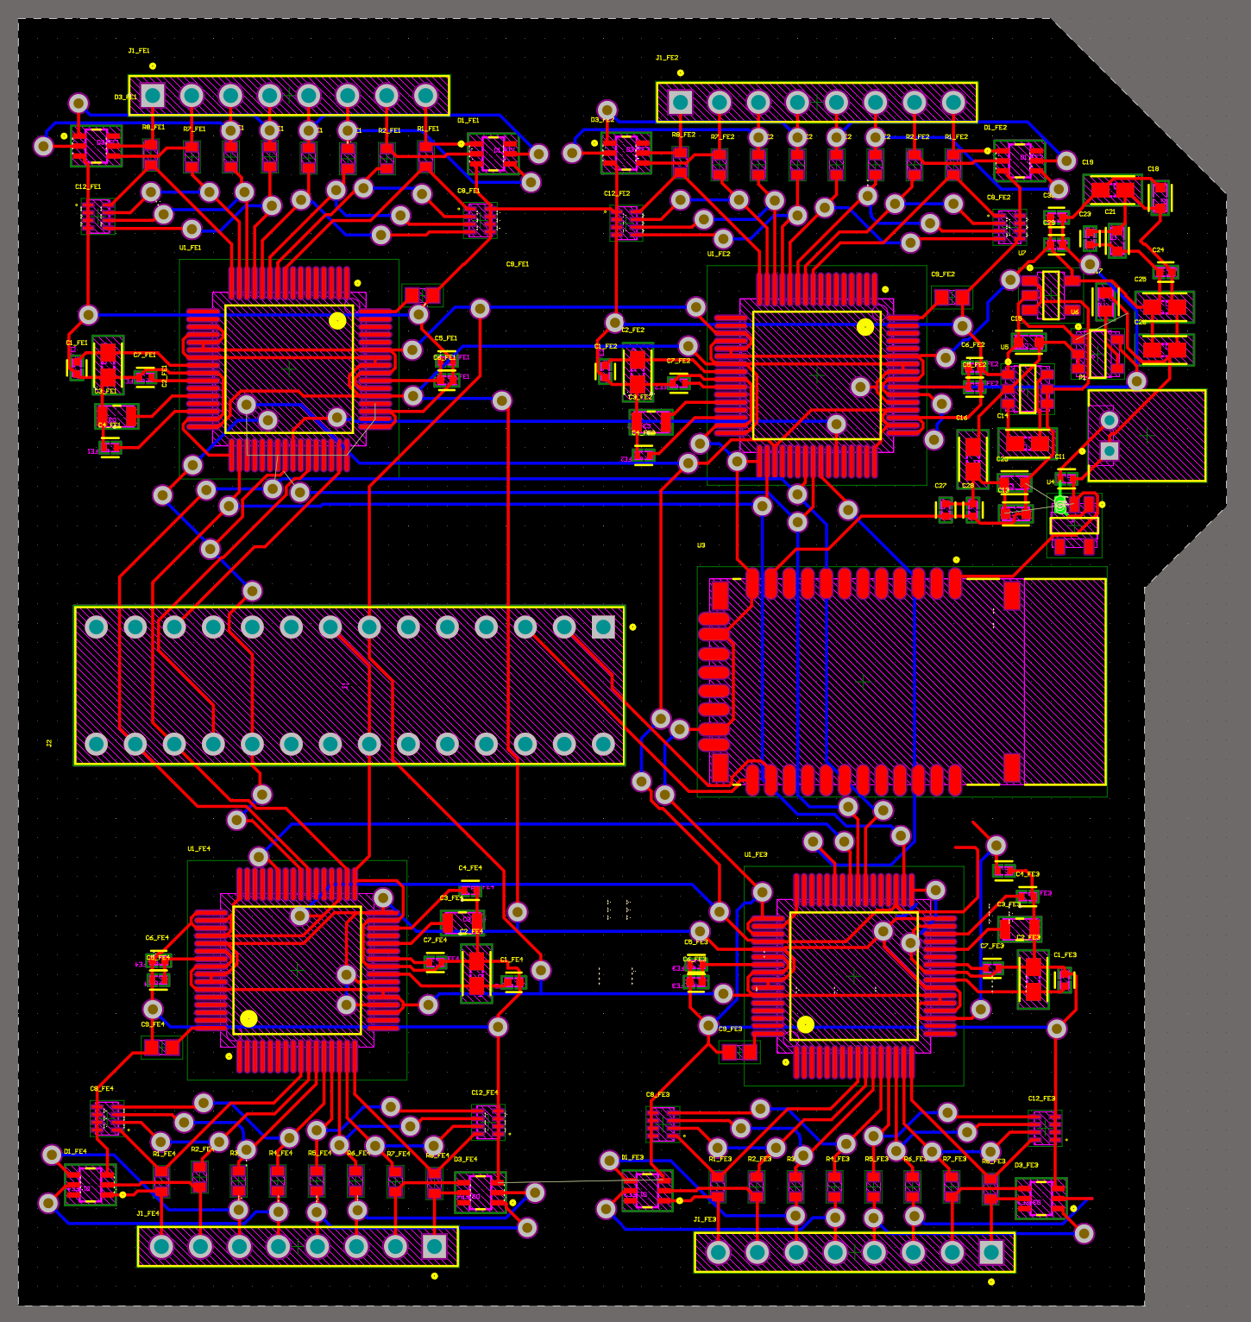
PCB
Frontend
Backend
Bluetooth
Power and Filtering
Notes:
A general information for the board specifications

Slide 9
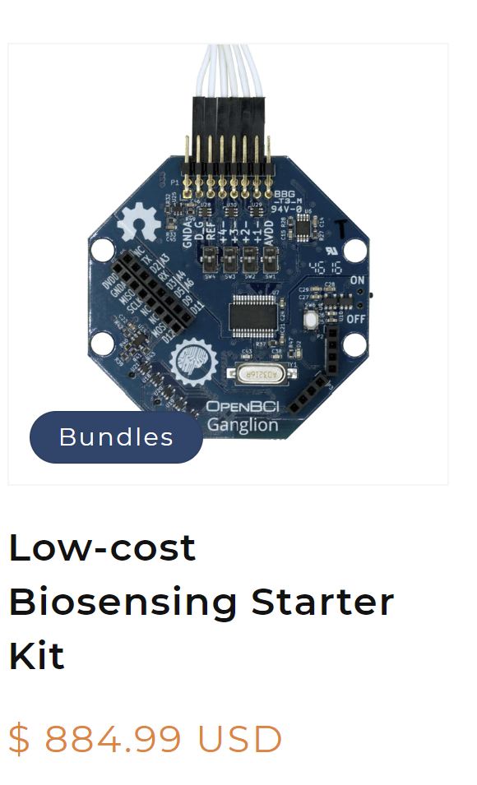
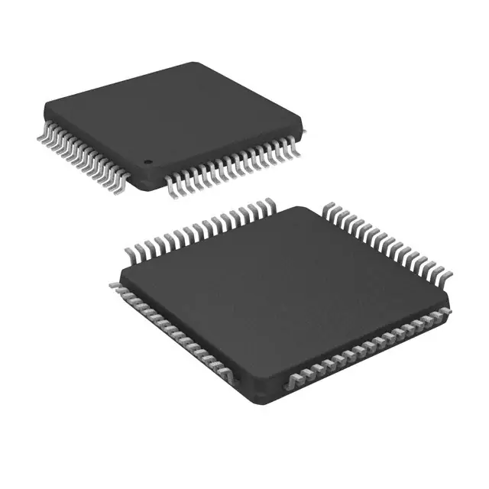
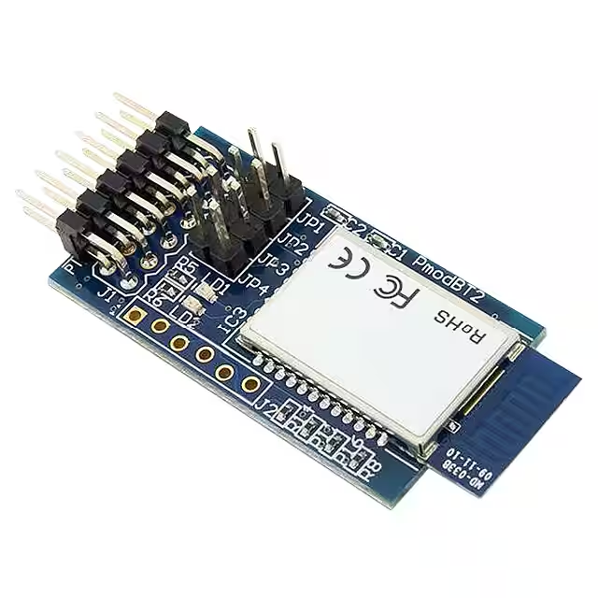
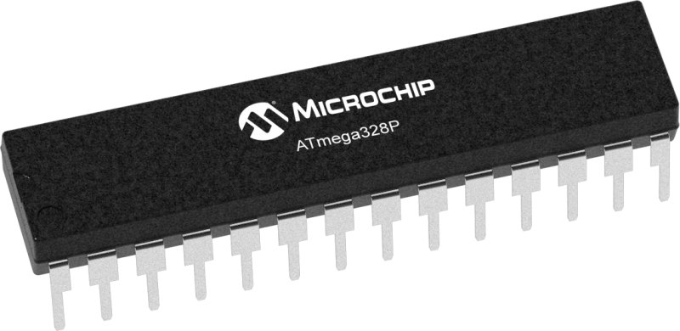
Price Comparison
4 * ADS1194 (2 * 4 Channels)
PmodBT2 / RN42
+
+
4 * $13.56
$29.99
ATMEGA328P-PU
+
PCB Board, Resistors, Capacitors, sockets, etc
$3.03
Unknown (assume $150)
$237.26
All images from Digi-Key, https://www.digikey.com/
Notes:
Explain the advantages of our board
Images are from Digi-Key
ADS1194: https://www.digikey.com/en/products/detail/texas-instruments/ADS1194CPAG/2440834
PmodBT2: https://www.digikey.com/en/products/detail/digilent,-inc./410-214/3902828
ATMEGA328P: https://www.digikey.com/en/products/detail/microchip-technology/ATMEGA328P-PU/1914589

Slide 10
Board Components
For our device, the device uses a microprocessor ATMEGA328P to control ADS1194 and PmodBT2
ATMEGA328P (Microprocessor)
Drive ADS1194
Handle Digital Data
ADS1194 (Analog Digital Converter)
Capture Analog Wave from Electrode
Convert to Digital Data to microprocessor
PmodBT2 (BlueTooth)
Transfer Digital Data to Computer

Slide 11
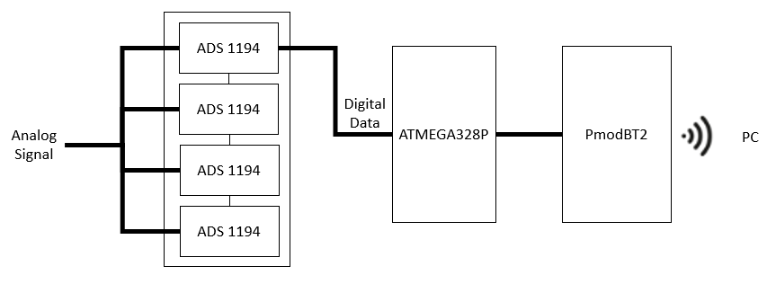
Board Components Connection
This is a general look up of how these components been connected and transfer the data to PC.

Slide 12
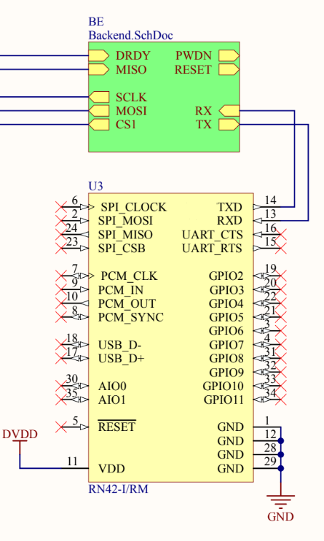
Components Implementation
The Green block represents Microprocessor, and Yellow represents Bluetooth model
PmodBT2
Pinout Description
RXD: Receive Digital Data from ATMEGA328P TX pin
VCC: 3.3V Power Supply followed User Manual
GND: Ground
TXD: Transmit Data (Connected with ATMEGA328P RX pin)
Implementation Step
Setup UART Baud Rate to 115200
Call Serial.print / Serial.write to send Digital Data
Display on COM Terminal Automatically Once received

Slide 13
Components Implementation
ATMEGA328P
Pinout Description
SPI Pins: Connect and Communicate with ADS1194
CS: Enable / Disable SPI communication
RESET: Reset to Default Setting
PDWN: Weekup internal oscillator to generate a 2.048MHz internal clock
DRDY: Status signal to indicate when data are ready
Implementation Step
Send WREG commands to setup the ADS1194 registers after RESET
Send RDATAC command to enable Read Data Continuous mode after START
Read data continuously from ADS1194 DOUT

Slide 14
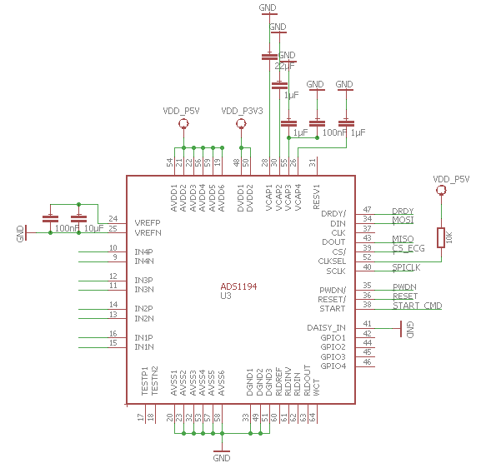
Components Implementation
ADS1194
Pinout Description
SPI Pins: Connect and Communicate with ATMEGA328P
DIN: Receiving Data from ATMEGA328P
DOUT: Sending Data to ATMEGA328P
RESET: Reset to Default Setting
PDWN: Weekup internal oscillator to generate a 2.048MHz internal clock
DRDY: Status signal to indicate when data are ready
START: Turn ON / OFF ADS1194
DAISY_IN: Ground or Receive DOUT when using Daisy_Chain Configuration
AVDD: Analog Power Supply
DVDD: Digital Power Supply
Fig 3: ADS1194 Connection
Image is drawn based on https://e2e.ti.com/support/

Slide 15
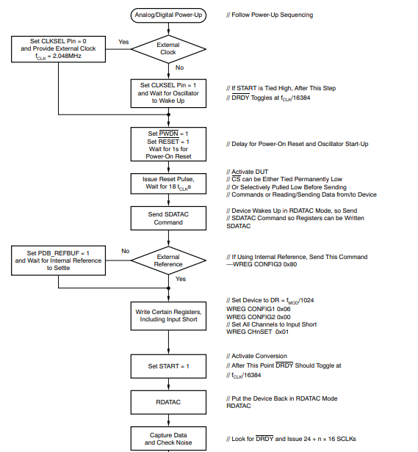
Components Implementation
ADS1194
Implementation Step
Power-Up
Set Clock and RESET to Default
Start ADS1194 once receive START command
Capture Analog Data from Input Channels once receive RDATAC command
Convert to Digital Data and send through DOUT

Slide 16
ISSUES
Problems we meet in this project

Slide 17
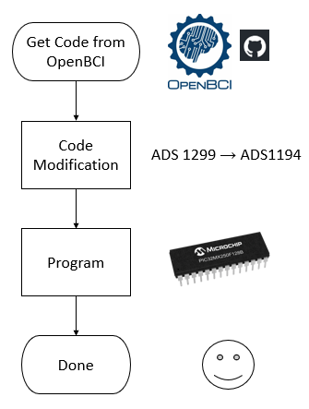
Issues
Ideal (What we planned)
Ideally, we will move parts of code from OpenBCI repo to our board.
That’s why we choose PIC32MX250F128B as the microcontroller since it is the same as OpenBCI use
The source code could be found in GitHub, OpenBCI/OpenBCI_Cyton_Library, openbci-archive/UDB32-MX2-DIP
Program the code using programmer PICkit 3

Slide 18

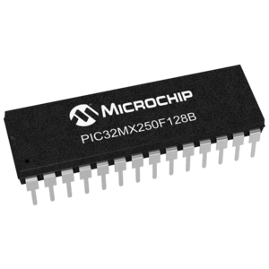
Issues
Fact (What is changed/different)
All usable OpenBCI source stops here (It only has their own board (Cyton Board) implementation Doc
We have to start using MPLAB X IDE to write our own program code
Lots of issues starts here….
We move and modified the code for ADS 1194 use on Arduino IDE into MPLAB X IDE
The function of ADC & microcontroller does not work as what we expect
Lack of resource that could help us debug in MPLAB X IDE (Deprecated & Most resource on Arduino IDE)

Slide 19
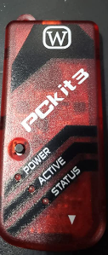
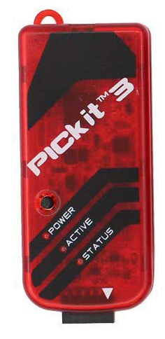
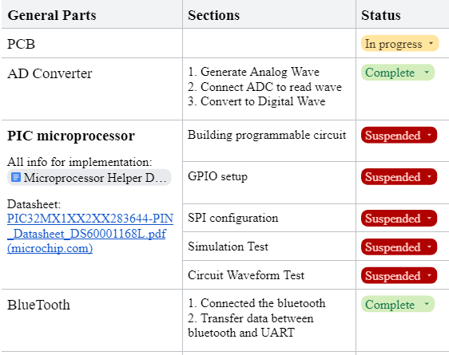
Issues
Fake
Authentic
Fact (What is changed/different) Continue
Fake Programmer !!!
During debugging, we often have unknown/random error relate to the programming
We check the code, connection, and the chip, it finally been notice that the programmer is a replica….
Fake one has text “PCkit 3” where it should be “PICkit 3”

Slide 20
Issues
Solution for PIC32MX250F128B
Due to time limitations, we decided to keep one team member to implement the PIC32MX250F128B, but tried to find another way to implement ADS 1194 for safety.
Fortunately, we find a GitHub repository for ADS 1194 Driver that supports ATMEGA328P microcontroller.
We tested the resource in Arduino IDE, and the serial monitor can return "ADS119X not started"
After reading the code, we deleted some code to skip an if statement to check the reason that caused it to return "ADS119X not started"

Slide 21
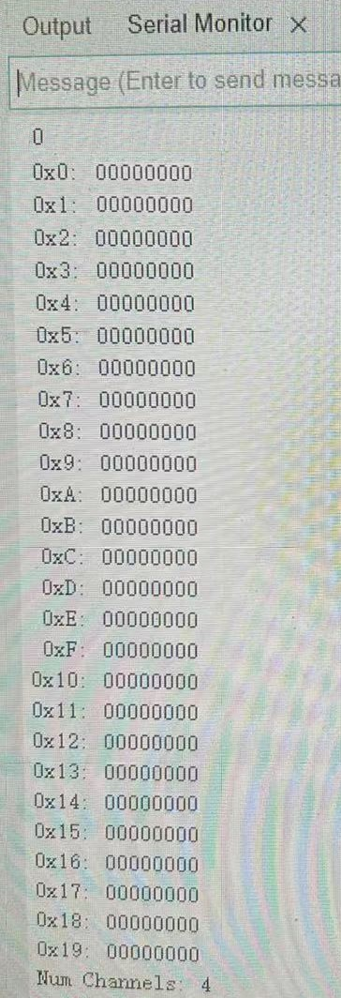
Issues
Failed to Initialize Correctly
Since we skipped the if statement that causes "ADS119X not started", the serial monitor returns 26 registers with all 0
At least, this resource code works, so one of our team members started to focus on implementing it in the Arduino IDE.
Based on ADS1194 User Manual, the 0x0 (ID) register is Read-Only, so the ID can’t be changed and will be
ID: 1011 0000
101: ADS119x device family
00: 4-channel ADS1194

Slide 22
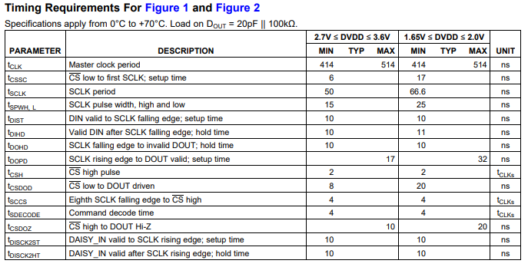
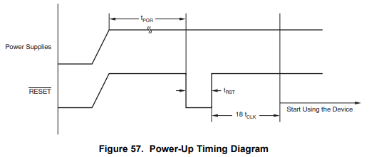
Issues
Solution
Follow the ADS1194 User Manual, I presume that the problem may be
Timing Issue
Power-Up Sequencing Issue
Pin Connection Issue
Wrong Voltage
Wrong Active Signal
Issue solved after we go through all the problems. The registers are correct and Channels start to output Digital Data

Slide 23
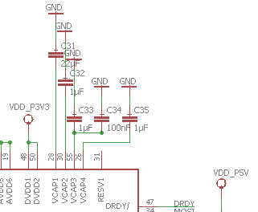
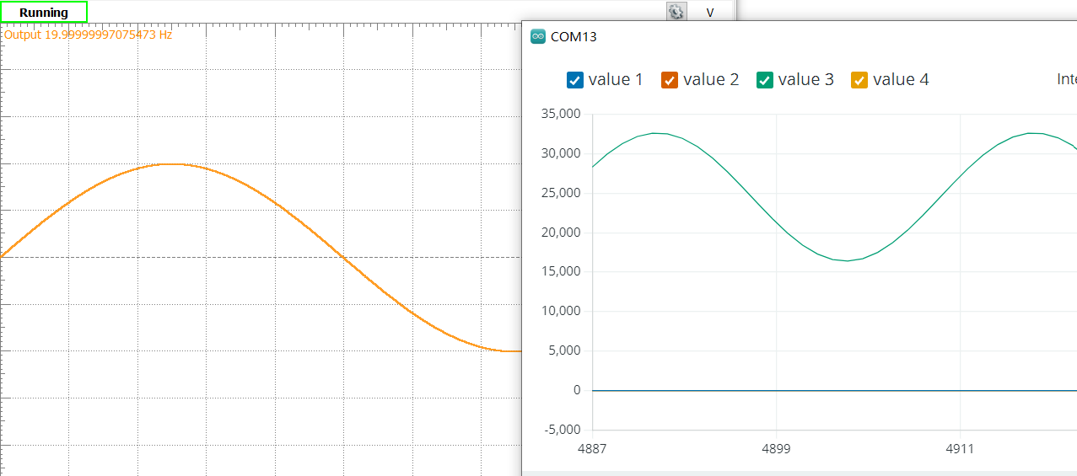
Issues
ADS1194 Only Output “1” (Almost Done)
When we first got the channel outputs, the results all are 32767
32767 = 16 bits 1
Bit size is correct, data doesn’t not
The analog is to annoying
After we grounded the unused channels, and set the inner Analog bypass capacitor of ADS1194 to ground with some capacitors, the wave that displayed on the Serial Plotter is the same as the Analog that we generated to use for simulation

Slide 24
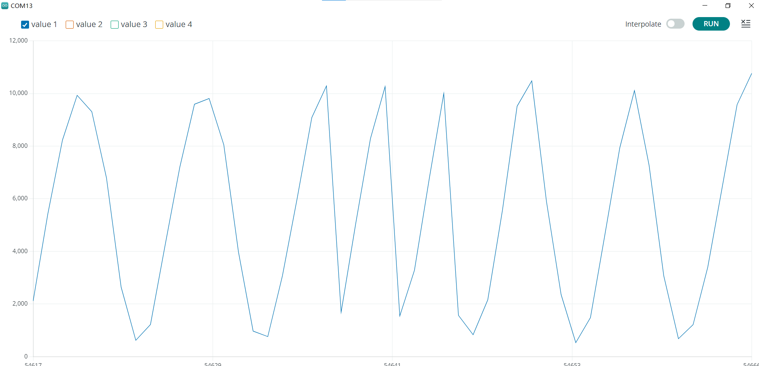
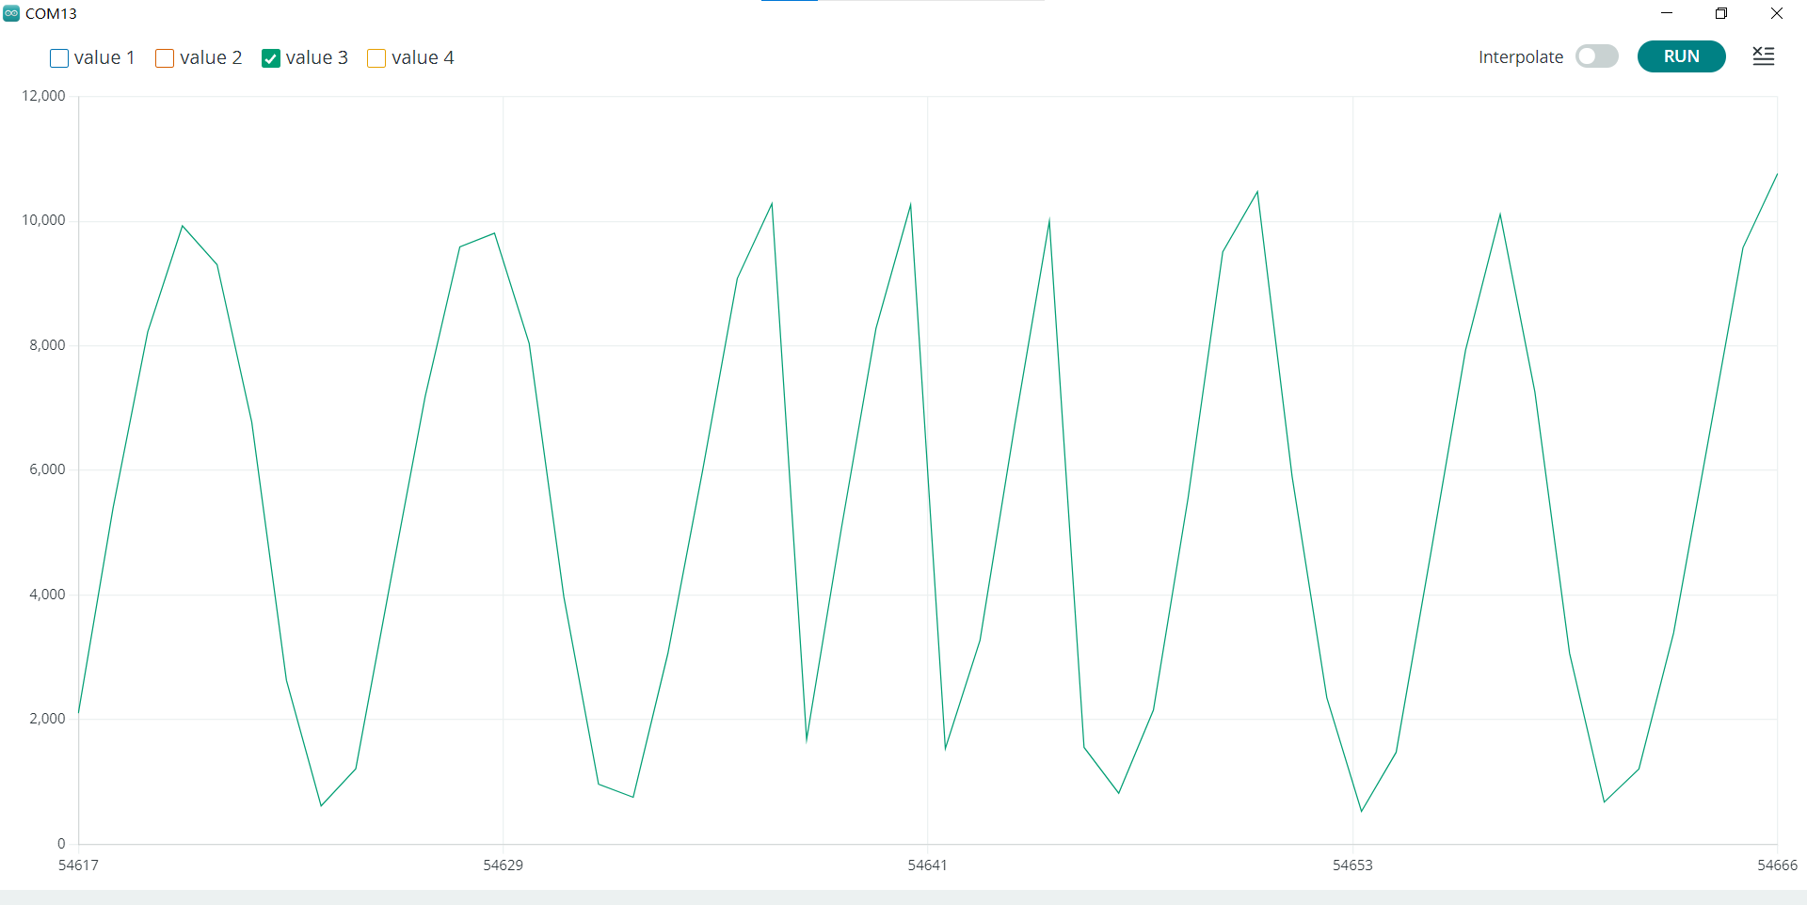
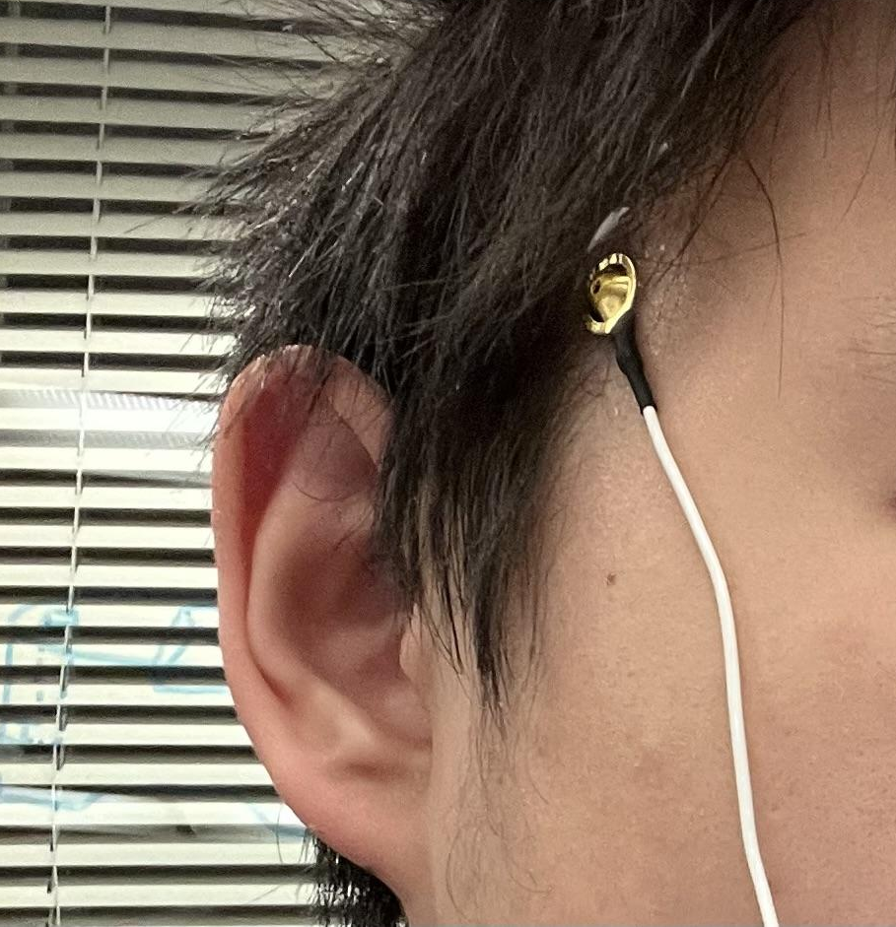
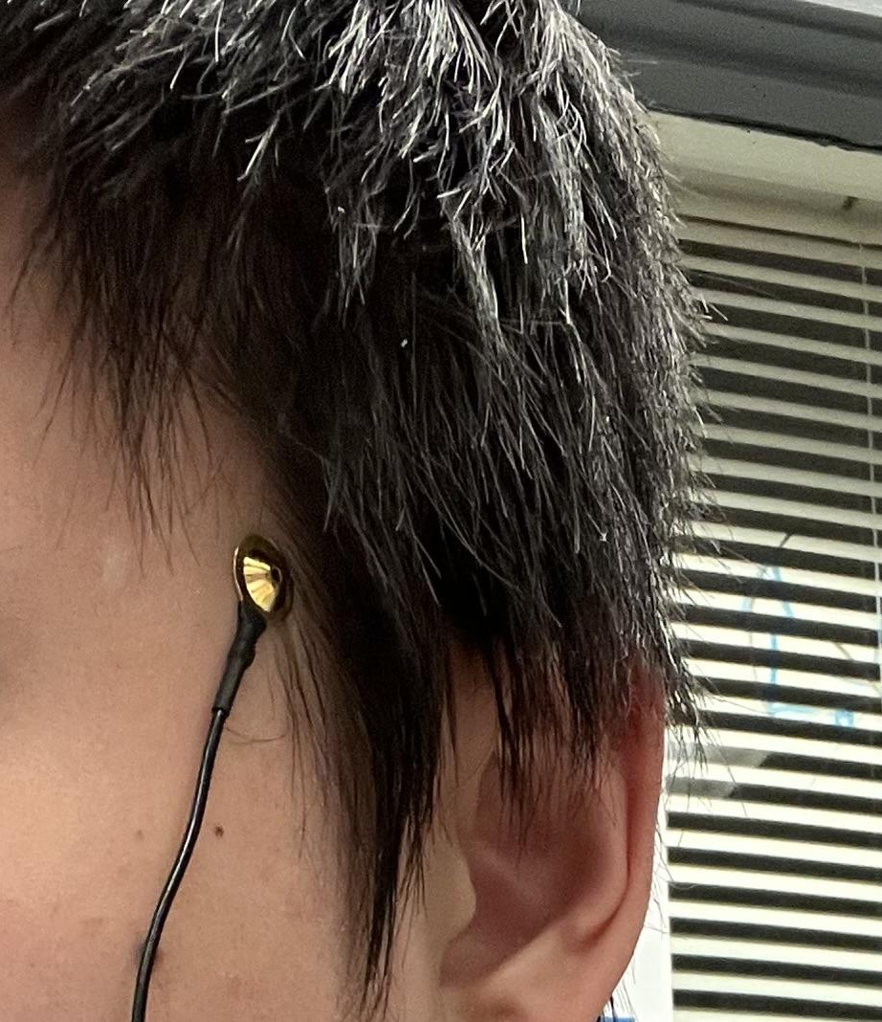
Issues
Prototype was Done
Last Step
We connected the bluetooth PmodBT2 and ADS1194 to the same microprocessor ATMEGA328P
Connect electrodes to EEG nodes on head

Slide 25
RESULTS
What we have for now

Slide 26
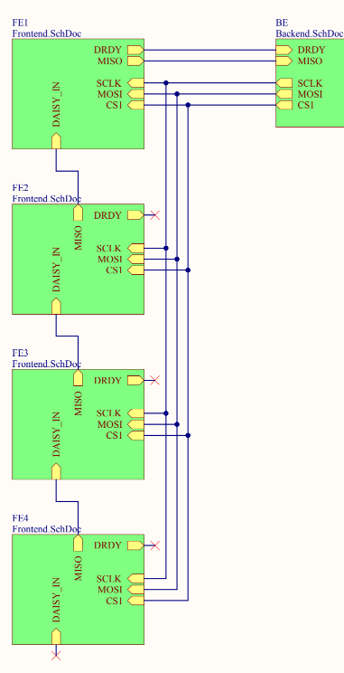
Results
What’s different from last semester design?
Chip change to ATMEGA328P
Only PCB Design Files
Fully work but we don’t have time to do the PCB fabrication
Only one ADS 1194 can be test & implement
To make all 4 ADS1194 work, only need to follow the daisy-chain mode to set up the ADS1194

Slide 27
DEMO
A simple demonstration on our prototype board.

Slide 28
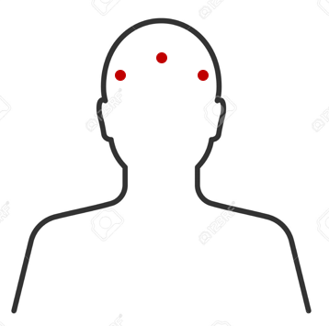
Demo
We will demonstrate how the project works by connecting 3 flat electrodes to obtain one frontal lobe measurement and two temporal lobe measurements.

Slide 29
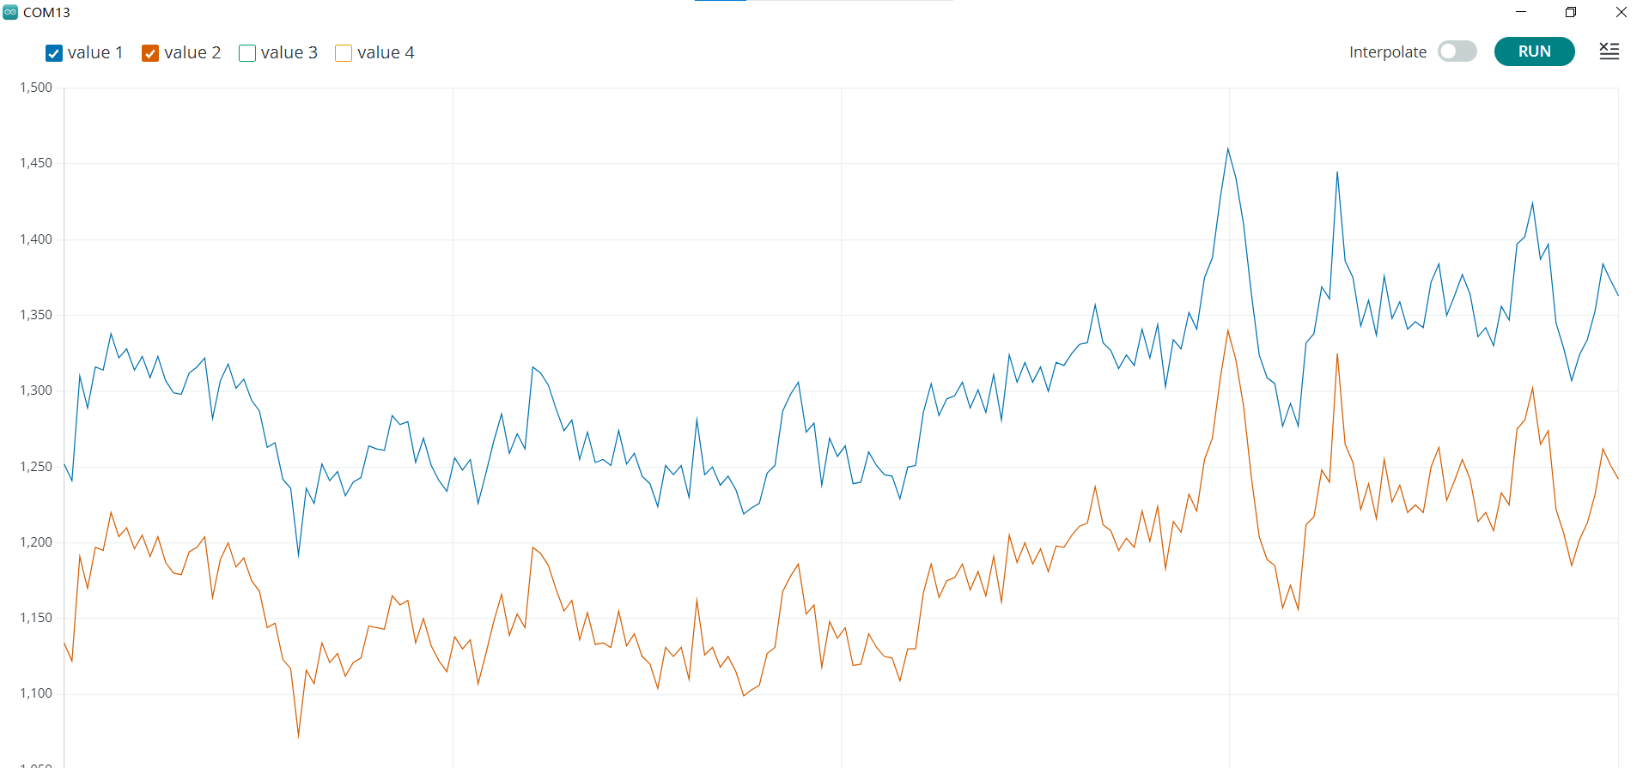

Slide 30
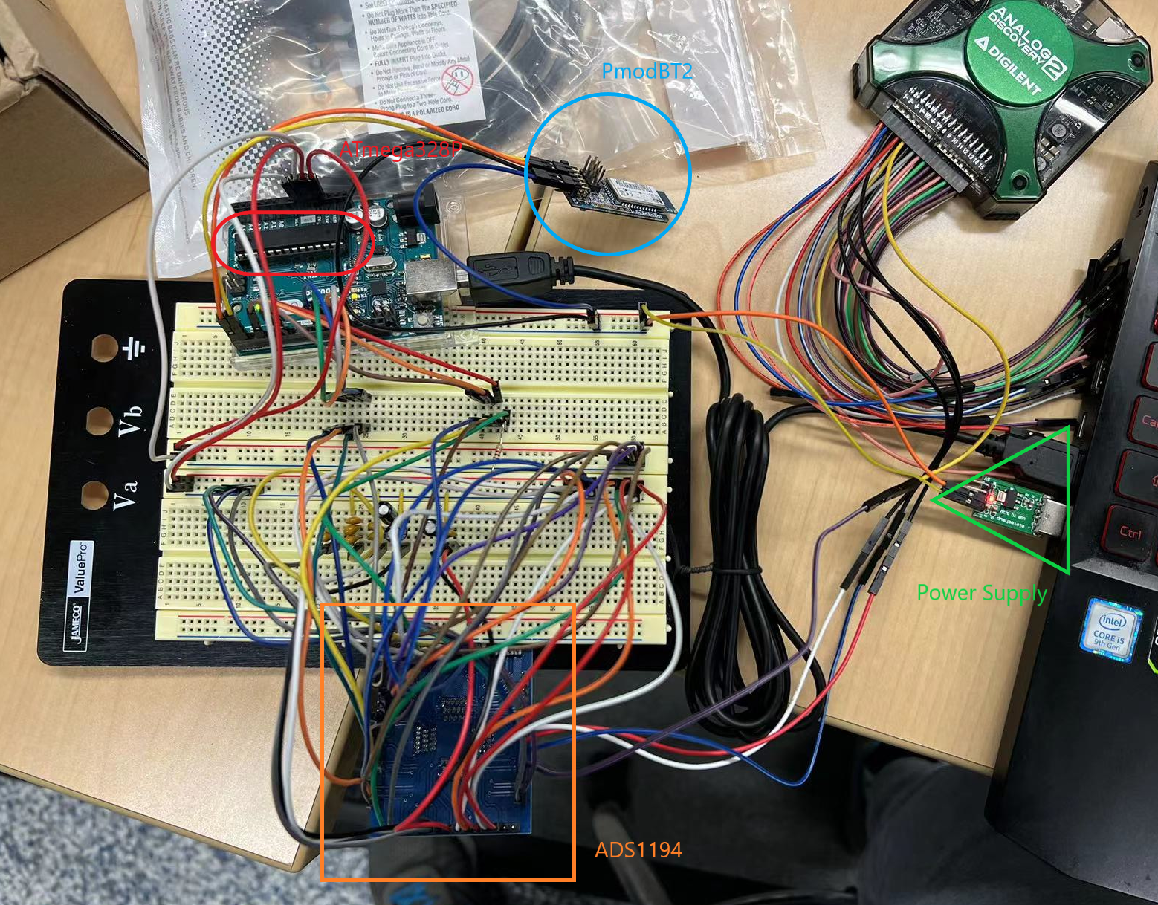
Delivery
A prototype board that can capture 4 analog signals and convert into digital data on Computer

Slide 31
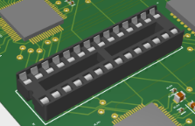
From prototype to PCB
A chip slot make PCB board more flexible
We replace a slot for microcontroller at that original position for PIC32MX250F128B rather than just swap the chip.
No more programmer need for this PCB board
Any implementation done on the Arduino Uno 3 can directly transfer to our PCB board by just insert the microcontroller into the slot
Easy to replace if microcontroller broken

Slide 32
What updates can be made in the future?
Extended 4 channel to 16 channel
USB connection (Power & Data transfer)
SD card storage
WiFi module

Slide 33
References
- OpenBCI Documentation. (2022, February 22). Retrieved from https://docs.openbci.com/
- 10-20 Internationally Accepted EEG Node Placement. (None). Retrieved from http://www.mariusthart.net/downloads/eeg_electrodes_10-20.svg
- ADS119X User Manual. (2010, April). Retrieved from https://www.ti.com/lit/ds/symlink/ads1194.pdf
- RN42 User Manual. (2013, March 26) Retrieved from https://ww1.microchip.com/bluetooth.pdf
- CSE450 Design Presentation. (2021, December 9) Retrieved from https://docs.google.com/presentation/

